Slide 1








DATA ANALYSIS
Module 3: SQL & Databases
Joining Tables
& Subqueries
Topic 4 of 6
Notes:
Recap the arc so far: 3.1 read a schema, 3.2 filtered one table, 3.3 summarised one table. Today is the first time two tables meet in one query — and the first time row-count prediction (mentioned since 3.1) becomes a real, necessary skill rather than a nice habit.

Slide 2


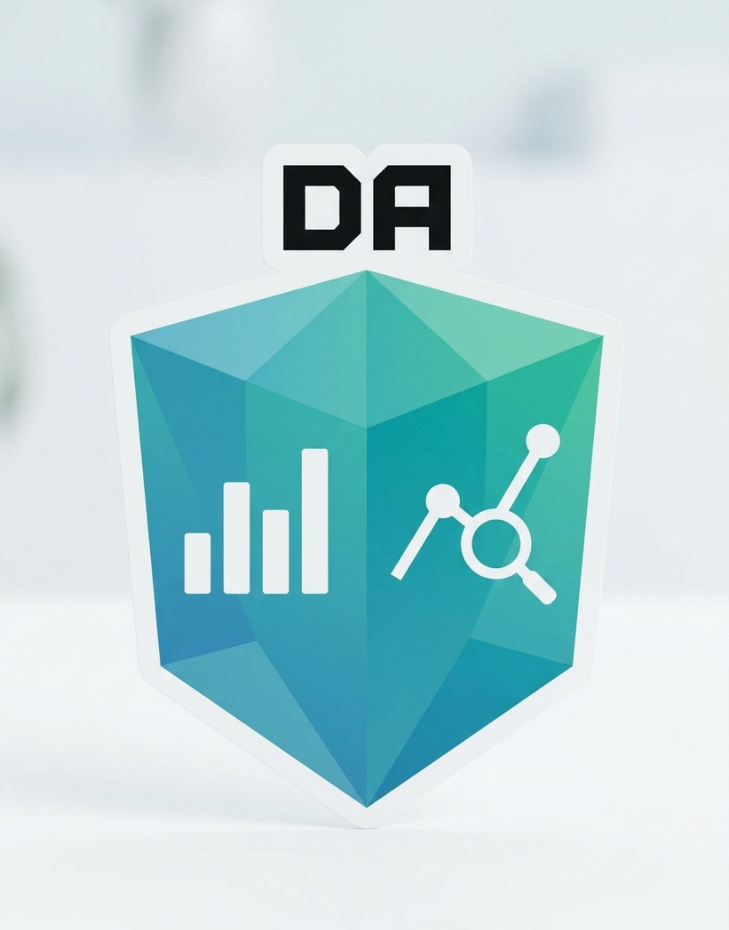


Learning outcome
By the end of this topic, the trainee can…
1- Use INNER JOIN and LEFT JOIN to bring matching rows from two tables together into one result.
2- Work out, before running it, roughly how many rows an INNER or LEFT join should return — and use that to catch mistakes.
3- Use a query nested inside another query to answer a question that needs a computed value or list first.

Slide 3
LEARNING OBJECTIVES
Two teams, two different problems
Support wants every order with the customer's name on it, so a rep doesn't have to look up two screens per ticket. That data lives in customers and orders — two different tables.
Marketing wants the opposite problem: customers who registered but have never placed a single order, for a first-purchase discount push.
Neither question can be answered from one table. Both need the tables joined — just in different ways.
That’s exactly what
INNER JOIN
LEFT JOIN
solve, respectively — matching rows only, or every row from one side whether it matches or not.

Slide 4
CONCEPT 1 OF 9
Two tables, one shared key
customer_id
full_name
city
From 3.1: customers has a primary key, customer_id — one row per customer, never repeated.
orders has its own primary key, order_id — but also a customer_id column, a foreign key pointing back to whose order it is.
That shared column is the hook a join hangs on: match customers.customer_id to orders.customer_id, row by row.
A customer can have many orders (one-to-many) — that's exactly why they're two tables, not one, going back to 3.1's spreadsheet problem.
101
Chidinma Okafor
Lagos
102
Tunde Bakare
Ibadan
103
Aisha Mohammed
Abuja
104
Emeka Nwosu
Lagos
105
Ngozi Eze
Port Harcourt
customers — 5 rows, one per person
order_id
customer_id
status
5001
101
Delivered
5002
101
Delivered
5003
103
Delivered
5004
104
Cancelled
orders — 4 rows; note 102 and 105 have none

Slide 5
CONCEPT 2 OF 9
INNER JOIN — only the matches
INNER JOIN pairs up rows from both tables wherever the ON condition is true.
If a customer has two orders, that customer appears twice — once per order.
If a customer has zero orders, they don't appear at all. INNER JOIN only keeps matched pairs.
full_name
order_id
status
Chidinma Okafor
5001
Delivered
Chidinma Okafor
5002
Delivered
Aisha Mohammed
5003
Delivered
Emeka Nwosu
5004
Cancelled
4 rows — Chidinma appears twice (2 orders); Tunde and Ngozi don't appear at all (0 orders).
SELECT c.full_name, c.city, o.order_id, o.status
FROM customers c
INNER JOIN orders o
ON c.customer_id = o.customer_id;
Reading the syntax
c and o are aliases — short nicknames so we don't repeat “customers.” / “orders.” everywhere.
ON says exactly which columns must match — always the key relationship from the schema.

Slide 6
CONCEPT 3 OF 9
Predicting an INNER JOIN's row count
The rule: for a one-to-many INNER JOIN (one customer, many orders), the row count equals the number of child rows (orders) that have a matching parent — not the number of customers.
customer
orders it has
rows it contributes
Predict-then-check, every join
Chidinma Okafor
2
2
Before running an INNER JOIN, count (or estimate) how many child rows have a matching parent.
Run the query. Compare the actual row count to your prediction.
Mismatch usually means: wrong join column, a duplicate key you didn't expect, or a filter applied in the wrong place.
Tunde Bakare
0
0
Aisha Mohammed
1
1
Emeka Nwosu
1
1
Ngozi Eze
0
0
Sum the right column: 2 + 0 + 1 + 1 + 0 = 4 rows — matches what we saw on the last slide.

Slide 7
CONCEPT 4 OF 9
LEFT JOIN — every row on the left, matched or not
LEFT JOIN keeps every row from the first (“left”) table, no matter what.
Where a match exists, its columns fill in normally — just like INNER JOIN.
Where no match exists, the right-hand table's columns come back as NULL instead of the row disappearing.
full_name
order_id
status
Chidinma Okafor
5001
Delivered
Chidinma Okafor
5002
Delivered
Tunde Bakare
NULL
NULL
Aisha Mohammed
5003
Delivered
Emeka Nwosu
5004
Cancelled
Ngozi Eze
NULL
NULL
SELECT c.full_name, o.order_id, o.status
FROM customers c
LEFT JOIN orders o
ON c.customer_id = o.customer_id;
6 rows — Tunde and Ngozi now appear once each, with NULL order columns.
NULL here means “no matching order”
Not zero, not blank, not an error — NULL is SQL's way of saying “there was nothing here to match.” That's exactly what marketing needs to find.

Slide 8
CONCEPT 5 OF 9
Predicting a LEFT JOIN, and finding “never ordered”
The rule: LEFT JOIN row count = matched child rows, plus one extra row for every parent with zero matches.
4 matched order rows (from the INNER JOIN count) + 2 zero-order customers (Tunde, Ngozi) = 6 rows. Matches the last slide.
Now isolate just the gap
full_name
SELECT c.full_name
FROM customers c
LEFT JOIN orders o
ON c.customer_id = o.customer_id
WHERE o.order_id IS NULL;
Tunde Bakare
Ngozi Eze
Exactly marketing's list — registered customers who have never ordered.
Why o.order_id, not o.customer_id: any column from the right-hand table works here — it's NULL only when nothing matched. Checking a left-hand column would never be NULL and wouldn't find the gap.

Slide 9
CONCEPT 6 OF 9
Which join do I actually want?
Ask one question: does this business question care about rows with no match, or only about matches?
Business question
Cares about non-matches?
Join
Every order with its customer's name
No — orders always have a customer
INNER JOIN
Customers who have never ordered
Yes — the whole point is the gap
LEFT JOIN
Total spend per city (from 3.3)
No — no join needed at all
single table
Every customer, with order count (0 if none)
Yes — zero must show as zero, not vanish
LEFT JOIN
Default assumption: start with INNER JOIN. Switch to LEFT JOIN only when you can name, out loud, why a non-matching row still belongs in the answer.

Slide 10
CONCEPT 7 OF 9
A query inside a query
Some questions are layered: you need one answer before you can ask the real question.
“Which customers spend more than average?” needs the average first — that's a query of its own.
A subquery is just that inner query, written in parentheses, in place of a value.
A scalar subquery returns exactly one value — here, one number: the average.
full_name
total_spent
Aisha Mohammed
210000
Chidinma Okafor
185000
Yusuf Ibrahim
132000
Fatima Bello
98000
The inner query runs first — AVG(total_spent) = 85800 — then the outer query filters against that one number.
Same 4 people HAVING found in 3.3
SELECT full_name, total_spent
FROM customers
WHERE total_spent > (
SELECT AVG(total_spent) FROM customers
)
ORDER BY total_spent DESC;
Back in 3.3, GROUP BY membership_tier HAVING AVG(total_spent) > 80000 surfaced the Gold tier — the same four people. Same answer, two different tools.

Slide 11
CONCEPT 8 OF 9
IN subquery — matching against a list
A scalar subquery returns one value. An IN subquery returns a list of values instead.
WHERE column IN (subquery) keeps rows whose column shows up anywhere in that list.
This answers: “which customers have at least one delivered order?” — without a JOIN at all.
full_name
Chidinma Okafor
Aisha Mohammed
The inner query returns {101, 103} — Emeka's order was Cancelled, so 104 isn't in the list.
Predict the subquery's list first
Same habit as everywhere else in this module: work out what the inner query should return before running the whole thing. If the outer result looks wrong, check the inner list on its own first.
SELECT full_name
FROM customers
WHERE customer_id IN (
SELECT customer_id FROM orders
WHERE status = 'Delivered'
);

Slide 12
PUTTING IT TOGETHER
Where JOIN fits in the skeleton
One more slot, in a fixed place: JOIN … ON always sits right after FROM, before WHERE.
→
→
→
→
→
SELECT
FROM
JOIN…ON
WHERE
GROUP BY
ORDER BY
columns
first table
second table (new)
rows (optional)
buckets (optional)
order (optional)
SELECT c.city, COUNT(o.order_id) AS order_count
FROM customers c
LEFT JOIN orders o ON c.customer_id = o.customer_id
GROUP BY c.city
ORDER BY order_count DESC;

Slide 13
WORKED EXAMPLE · PART 1 OF 2
Support's single-screen order view
Business question: “Show every order with the customer's name on the same row.”
Step 1 — predict before writing anything
Step 2 — write the join
Every order needs a customer, and every customer here is real — so an INNER JOIN should return exactly one row per order: 4 rows.
SELECT o.order_id, c.full_name, o.status
FROM orders o
INNER JOIN customers c
ON o.customer_id = c.customer_id;
Notice: we started FROM orders this time, not customers — order doesn't matter for an INNER JOIN's result, only which columns you can reach through each alias.
Next: run it, confirm the row count, and hand support the same view sorted for their queue → continued on the next slide.

Slide 14
WORKED EXAMPLE · PART 2 OF 2
Checking the count, then finishing the view
order_id
full_name
status
SELECT o.order_id, c.full_name, o.status
FROM orders o
INNER JOIN customers c
ON o.customer_id = c.customer_id
ORDER BY c.full_name;
5003
Aisha Mohammed
Delivered
5001
Chidinma Okafor
Delivered
5002
Chidinma Okafor
Delivered
5004
Emeka Nwosu
Cancelled
Verify: 4 rows came back — matches the prediction from step 1. Safe to hand to support.
If the count hadn't matched
More than 4 rows? A customer_id likely appears more than once in customers — check for a duplicated key.
Fewer than 4? An order's customer_id may not exist in customers at all — that's a data problem worth flagging, not a query bug.
This is exactly what row-count prediction is for: catching a real data issue before it reaches support.

Slide 15
GUIDED PRACTICE · YOUR TURN
Marketing's first-purchase list
Business question: Marketing wants two lists: (1) registered customers who have never placed an order, and (2) using a subquery instead, customers who have never had a Delivered order. Do both give the same names here?
Your task
Before you run it
Query 1: LEFT JOIN customers to orders, keep only rows where the order side is NULL.
Query 2: SELECT customers whose customer_id is NOT IN the list of customer_ids with a Delivered order.
Predict each row count before running it.
Compare the two customer lists — are they identical?
Remember: Emeka's only order was Cancelled, not Delivered.
Write down which list you expect to be longer, and why, before running either query.
NOT IN needs the subquery's list to have no NULLs in it — keep that in mind if your result looks wrong.
Stuck on an error? Ask AI to explain it — not to rewrite the query.

Slide 16
GUIDED PRACTICE · SOLUTION
Two correct queries, two different lists
Query 1 — never ordered at all
Query 2 — never had a Delivered order
SELECT c.full_name
FROM customers c
LEFT JOIN orders o ON c.customer_id = o.customer_id
WHERE o.order_id IS NULL;
SELECT full_name
FROM customers
WHERE customer_id NOT IN (
SELECT customer_id FROM orders
WHERE status = 'Delivered');
full_name
Tunde Bakare
full_name
Ngozi Eze
Tunde Bakare
Emeka Nwosu
Ngozi Eze
Not the same list — and that's correct: Emeka placed an order, so Query 1 excludes him. But it was Cancelled, never Delivered, so Query 2 includes him. Two different questions, two right answers.

Slide 17

Key Takeaways
You can now combine tables with INNER and LEFT joins: INNER JOIN keeps only matches; LEFT JOIN keeps every row from the left table, matched or not.
Up Next:
Warehousing
Fundamentals
You can now predict a join's row count before running it: Count matching child rows for INNER; add one row per unmatched parent for LEFT — then check your prediction against reality.
You can now use subqueries to answer layered questions: A scalar subquery hands back one value; an IN subquery hands back a list — both let one query feed another.

Slide 18
WHAT'S NEXT
From this session into the lab
1
2
3
Hands-on lab
LMS practice set
Keep the habit
Open the shared customers.db / orders.db and complete the 3.4 lab worksheet — INNER and LEFT join tasks, each with a written row-count prediction.
Ten auto-graded questions: choosing INNER vs LEFT, predicting row counts, and writing scalar and IN subqueries.
For every join or subquery, write your prediction first. Bring one join whose actual count surprised you to the next session.
Facilitator note: pre-built finished lab file (customers_orders_joins_finished.db) and a printed answer key with expected row counts are attached on the LMS in case the live demo or network fails.

